Slide 1

The elbow
Lecture
Semmelweis University

Slide 2
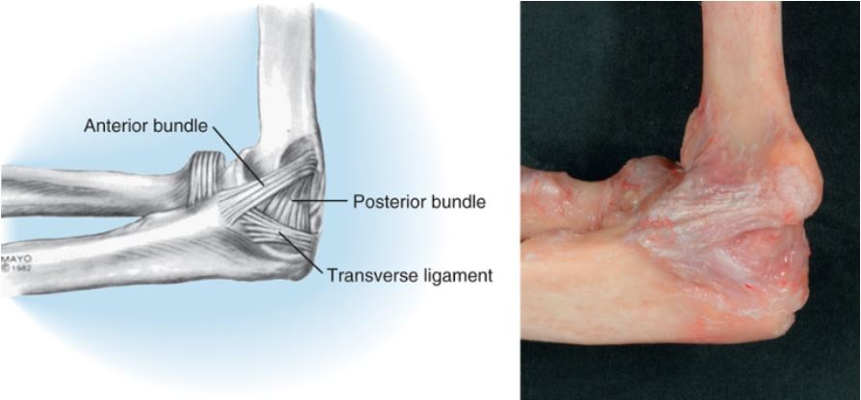
Medial collateral ligament
Anatomy
Notes:
The classic orientation of the medial collateral ligament, including the anterior and posterior bundles, and the transverse ligament. This last structure contributes relatively little to elbow stability.

Slide 3
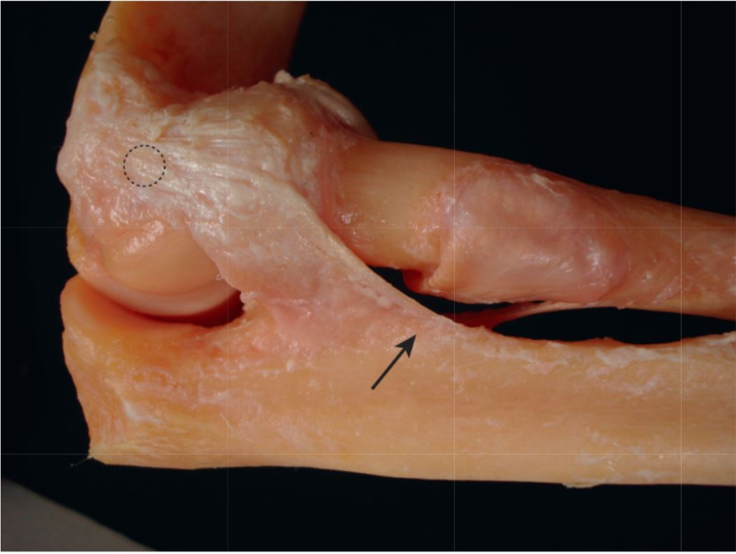
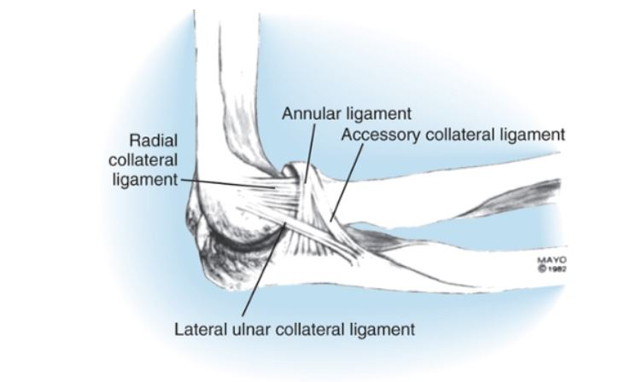
Lateral collateral ligament
Anatomy
Notes:
Dissection demonstrating the “Y” orientation of the lateral collateral ligament complex. Schematic representation of the radial collateral ligament complex showing several portions, one of which, termed the radial collateral ligament, extends from the humerus to the annular ligament. This is the portion that is implicated in clinical instability.

Slide 4
Tendinosis around the elbow

Slide 5

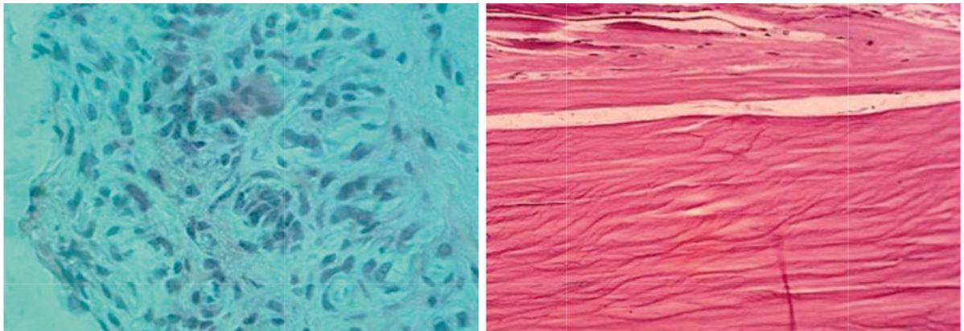

What is tendinosis?
Notes:
A) Angio-fibroblastic tendinosis: immature vascular and fibroblastic elements, no inflammatory cells. (B) Normal tendon.

Slide 6

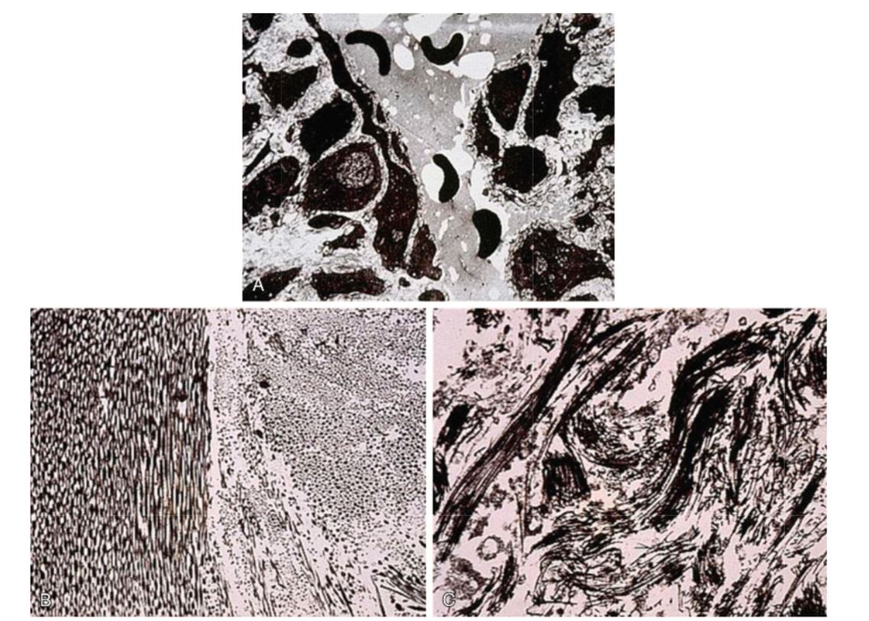
What is tendinosis?
Notes:
(A) Immature nonfunctional vascular elements. Lumens are not complete. (B) Normal tendon. Orderly collagen. (C) Tendinosis. Major collagen disruption.

Slide 7
Tennis elbow
The term lateralis tendinosis is more accurate than Epicondylitis, as it better describes the underlying pathology. Tendinosis affecting the lateral side of the elbow is five times more frequent than tendinosis on the medial side.
Tendinosis typically affects the origin of the extensor carpi radialis brevis, but in nearly 50 percent of the cases the origin of the extensor digitorum communis is also affected.

Slide 8

Clinical examination of tennis elbow

Slide 9
When to operate?
1. Athe severity of pain is so intense that it affects the everyday activities and working capacity of the patient.
2. Pain is focused at the ECRB and/or EDC origin, distal to the epicondyle.
3. 6 months of conservative management proves ineffective. Conservative management typically means altering activities, counterforce bracing, topical or systematic anti inflammatory treatment and complex physiotherapy under expert supervision.
4. an increasing bulk of evidence has been published on the harmful effect of steroid injections, henceforth they should be avoided if possible. Persisting tennis elbow pain following a steroid injection is no longer a criterion of operative treatment.

Slide 10
Stages of pain when conservative management is preferable
1. phase mild pain following activities which resolves spontaneously after 24 hours
2. phase mild pain before the activity relieved by warm up. The activity itself is pain free but discomfort returns afterwards. Pain eventually settles within 48 hours.
3. phase warmup provides only partial relief of pain. The patient is still able to accomplish the painful activity.
4. phase Activities need to be modified to cope with the pain, which also appears in other activities of everyday life.
5. Phase pain affects activities of everyday life, but the patient is still able to cope with activity modifications.

Slide 11
Stages of pain when operative management is typically preferable
6 phase tPain is not relieved by complete rest, the patient is unable to accomplish certain tasks
7 phase strong pain during every day activities accompanied by night pain

Slide 12
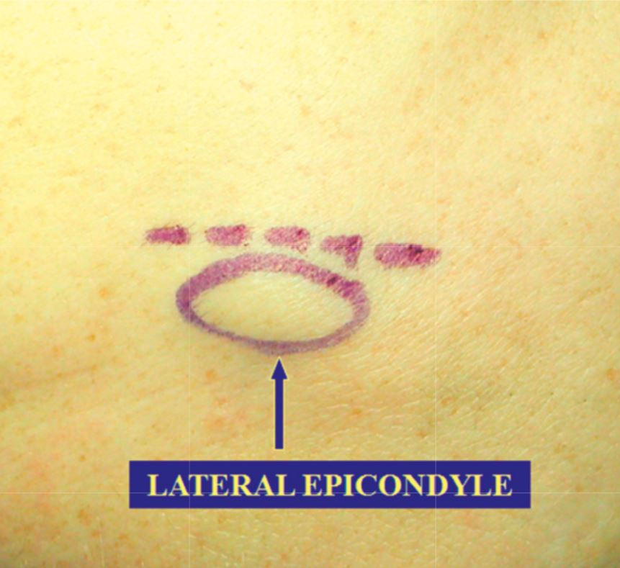
Lateral tendinosis surgical approach
Skin incision
Notes:
Proper placement of incision just anteromedial to the lateral epicondyle is critical to allow direct access to the extensor carpi radialis longus–extensor digitorum communis tendon interface.

Slide 13
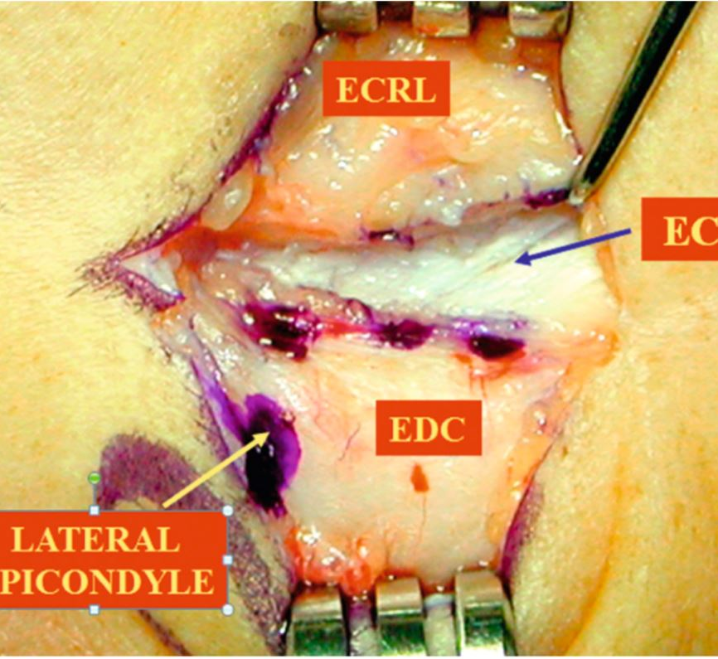
Lateral tendinosis surgical approach
Notes:
The interface should be easily identified as the extensor carpi radialis longus (ECRL) muscle is soft and the extensor digitorum communis (EDC) aponeurosis is firm. The extensor carpi radialis brevis (ECRB) comes into the EDC and lateral epicondyle at a 20-degree angle and lies just under the ECRL.

Slide 14
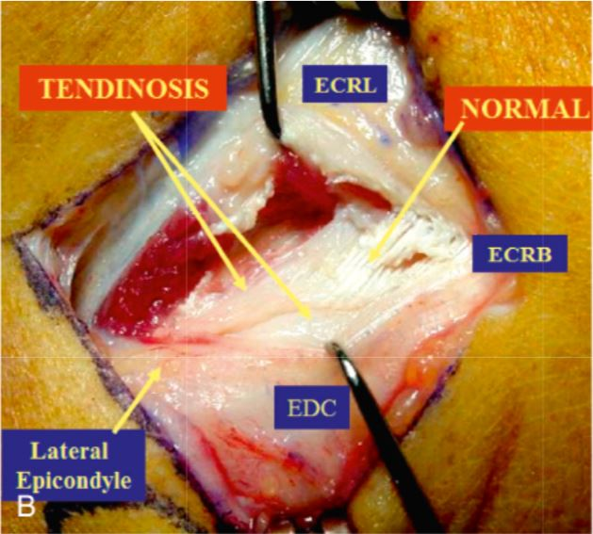
Lateral tendinosis surgical approach
Notes:
Surgical photo. Note a small amount of shiny normal ECRB distally. EDC, Extensor digitorum communis.

Slide 15
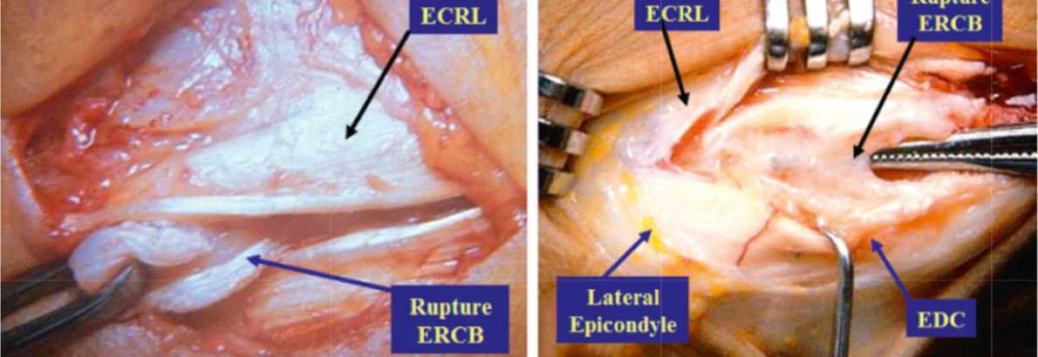
Lateral tendinosis
Notes:
(A,B) Examples of complete extensor carpi radialis brevis (ECRB) tears and avulsion in world-class tennis players. ECRL, Extensor carpi radialis longus; EDC, extensor digitorum communis.

Slide 16
Medial elbow tendinosis or golfers’ elbow
Typically affects the conjoined tendon of the common flexor origin, sometimes accompanied by ulnar nerve neuropathy (30-50%).
Insufficiency or disease of the medial collateral ligament is an important differential diagnosis
Clinical tests include resisted wrist flexion with the forearm in supination, with a straight or bent elbow

Slide 17
Stages of pain when conservative management is preferable
1. phase mild pain following activities which resolves spontaneously after 24 hours
2. phase mild pain before the activity relieved by warm up. The activity itself is pain free but discomfort returns afterwards. Pain eventually settles within 48 hours.
3. phase warmup provides only partial relief of pain. The patient is still able to accomplish the painful activity.
4. phase Activities need to be modified to cope with the pain, which also appears in other activities of everyday life.
5. phase pain affects activities of everyday life, but the patient is still able to cope with activity modifications.

Slide 18
Stages of pain when operative management is typically preferable
6 phase tPain is not relieved by complete rest, the patient is unable to accomplish certain tasks
7 phase strong pain during every day activities accompanied by night pain

Slide 19
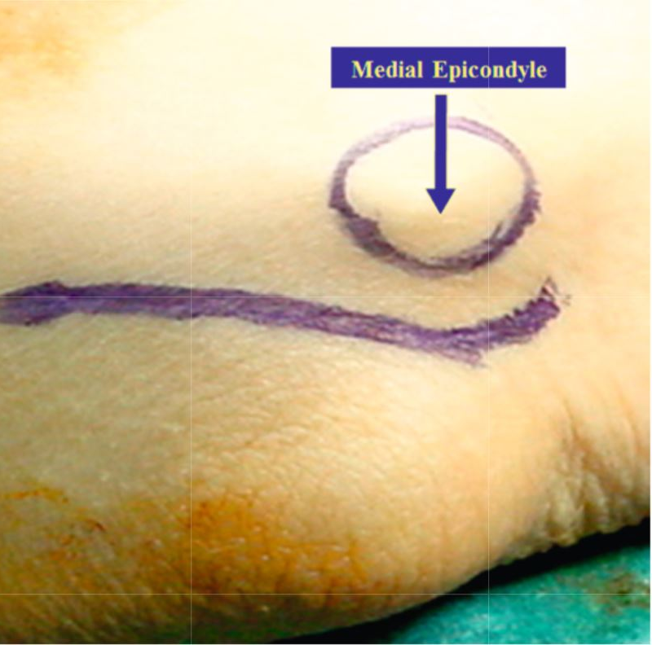
Medial tendinosis exposure
Notes:
An initial incision approximately 2 inches in length is placed posterior and distal to the epicondyle. Posterior placement avoids the medial antebrachial cutaneous nerves and allows direct access to the cubital tunnel and medial epicondyle.

Slide 20
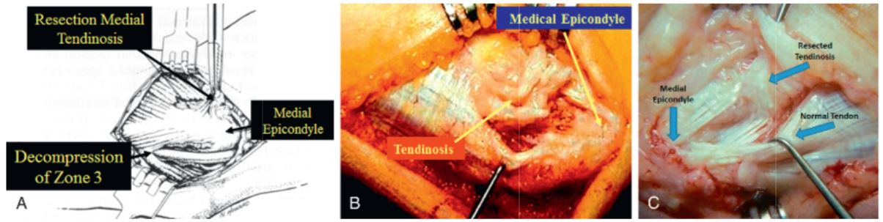
Medial tendinosis
Notes:
A) Through a longitudinal elliptical excision the pathology is usually located in the flexor carpi radialis and to some degree in the medial edge of the pronator teres, and on occasion the lateral edge of the flexor carpi ulnaris. (B,C) Surgical photos depicting excision of extensive tendinosis. Note: the shiny normal tendon areas are not disturbed.

Slide 21
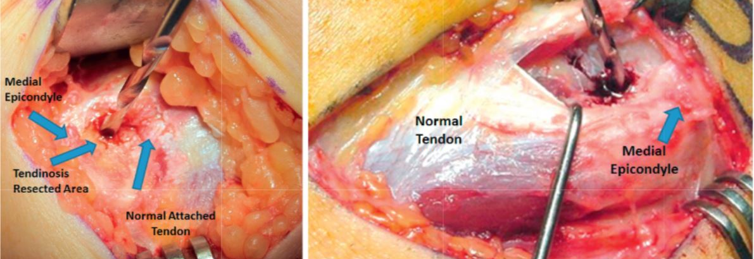
Medialis tendinosis
Notes:
A small drill hole distal to the medial epicondyle is made through cortical bone to cancellous bone depth to enhance vascular supply and tendon healing. (A) Drilling after scratch technique tendinosis resection. (B) Drilling after elliptical en bloc dissection resection.

Slide 22
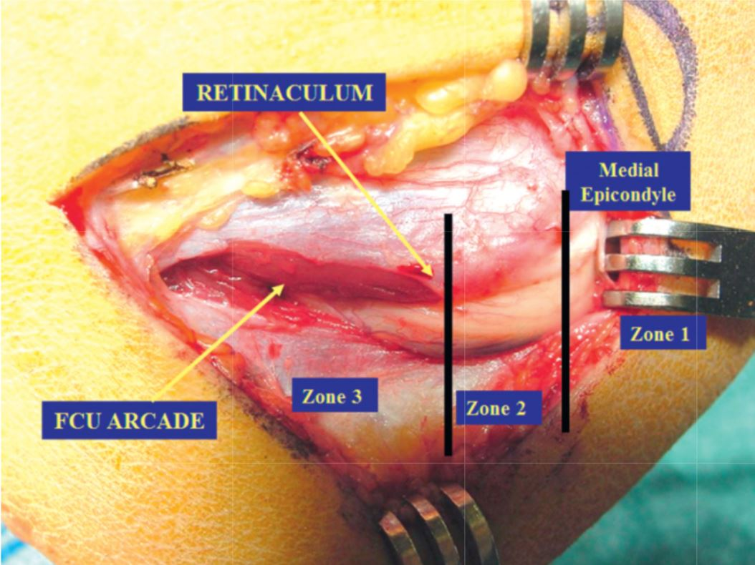
N. Medianus felszabadítás
Notes:
Three zones are recognized: zone 1, proximal to medial epicondyle; zone 2, at medial epicondyle; and zone 3, distal to epicondyle. Zone 3 is the most common area of ulnar nerve compression with resultant clinical neuropraxia. FCU, Flexor carpi ulnaris.

Slide 23
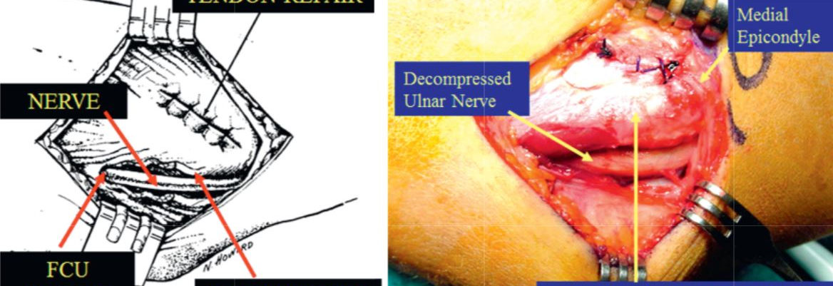
Medialis tendinosis
Notes:
When closing an elliptical resection, if there is a sense of excessive tension at the cubital tunnel, decompression of the cubital tunnel is recommended even in the absence of preoperative nerve symptoms. FCU, Flexor carpi ulnaris.

Slide 24
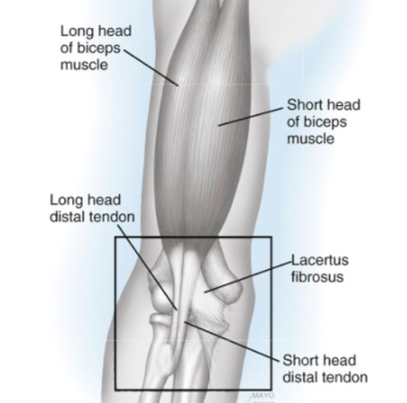
Distal biceps rupture
Notes:
The biceps complex originates at the shoulder and inserts on the bicipital tuberosity of the radius. The long head of the biceps originates from the superior glenoid tubercle; the short head originates from the coracoid process. The biceps mechanism rotates 90 degrees externally from origin to insertion such that the short head part of the distal biceps tendon inserts distally and ulnarly on the bicipital tuberosity, and the long head portion inserts proximally and ulnarly.

Slide 25
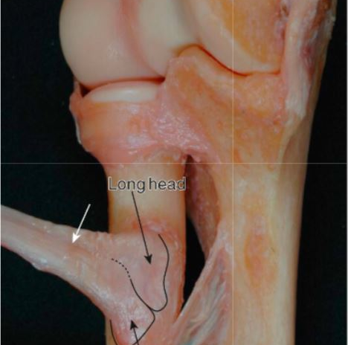
Distal biceps
Notes:
Dissection demonstrating the subtle distinction between the two tendons (white arrow) and the far ulnar attachment of the distal biceps tendon on the bicipital tuberosity. Note that the short head tendon attaches distally and the long head tendon attaches proximally.

Slide 26
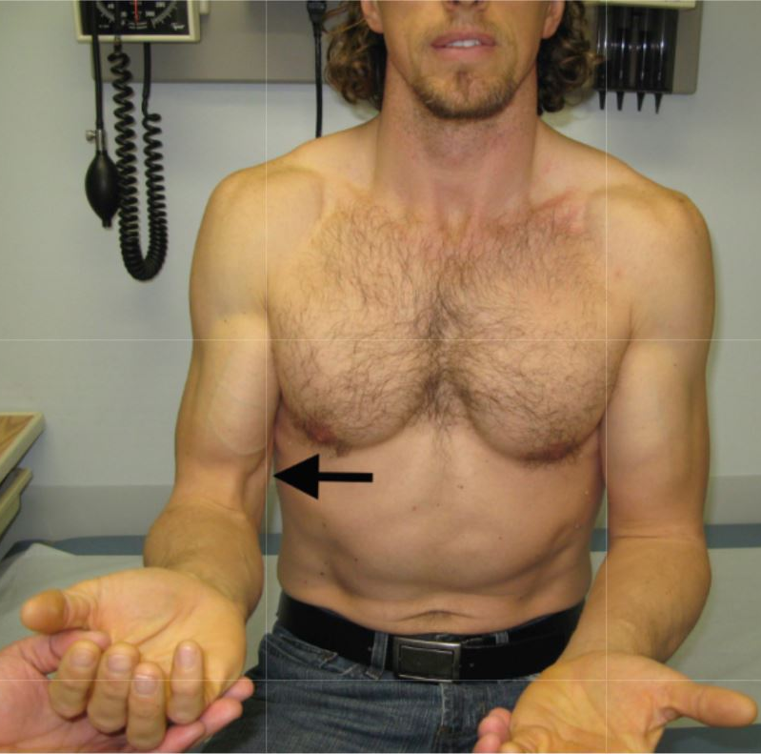
Distal biceps rupture
Notes:
This active patient sustained an acute rupture of the left distal biceps tendon. On the right, note that with forearm supination (A), the biceps muscle normally rises or contracts proximally (black arrow). However, on the injured left side, there is loss of definition without movement of the muscle belly. (B) With forearm pronation, the intact right muscle belly falls or slides distally, whereas the injured left side remains unchanged.

Slide 27
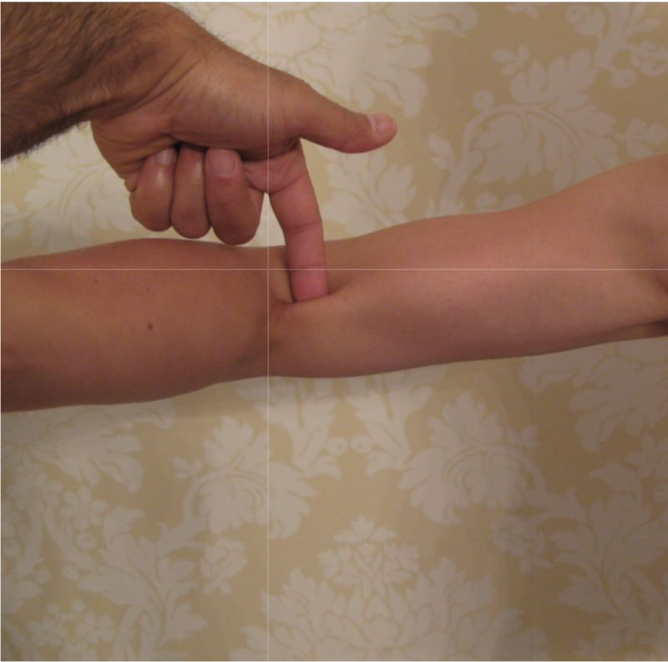
Hook teszt
Notes:
The hook test is based on palpation of the intact distal biceps tendon in the antecubital fossa. The test is performed with the patient actively abducting the shoulder to 90 degrees, elbow flexed to 90 degrees, and forearm in full supination. The examiner uses his or her index finger to hook the distal biceps tendon from lateral to medial across the antecubital fossa. The maneuver is conducted laterally to medially to avoid mistaking the intact lacertus as the biceps tendon.

Slide 28
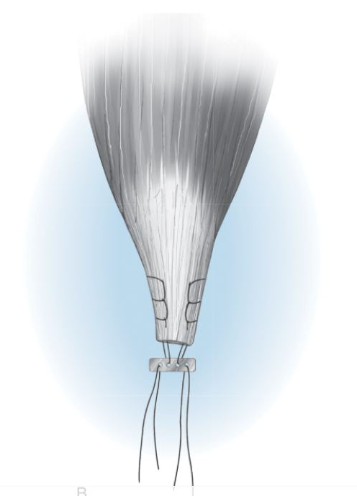
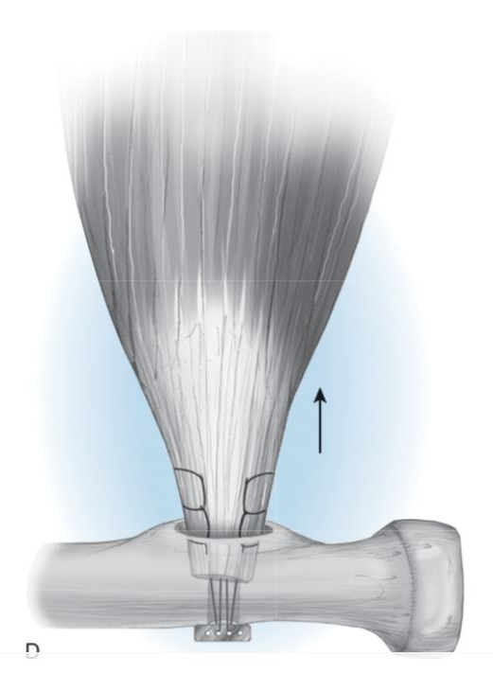
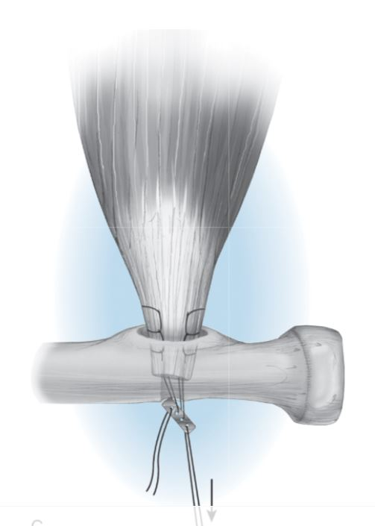
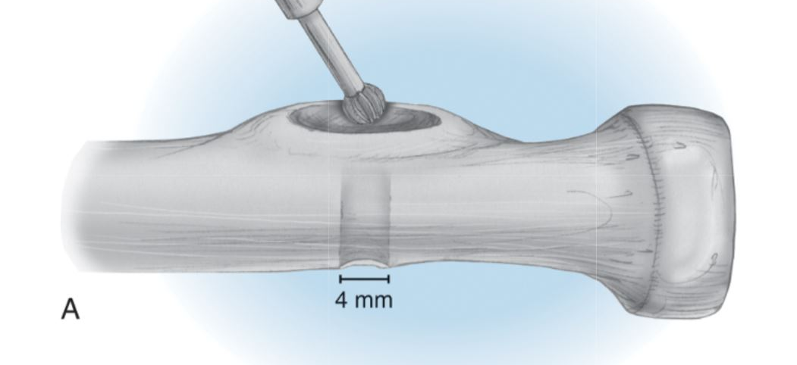
Operative treatment
Notes:
Conservative management of a distal biceps rupture results in obvious weakness predominantly in supination.

Slide 29
Elbow instability

Slide 30
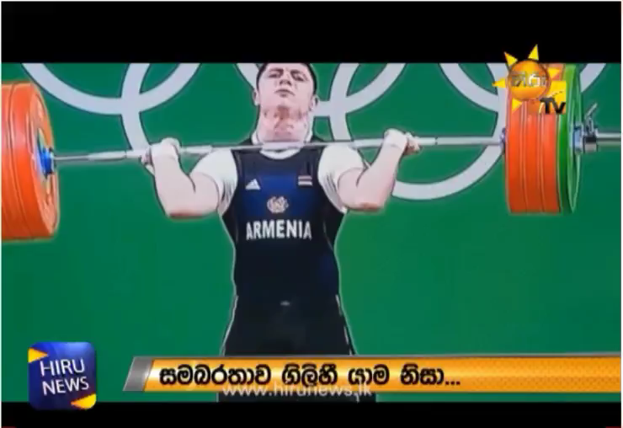

Slide 31
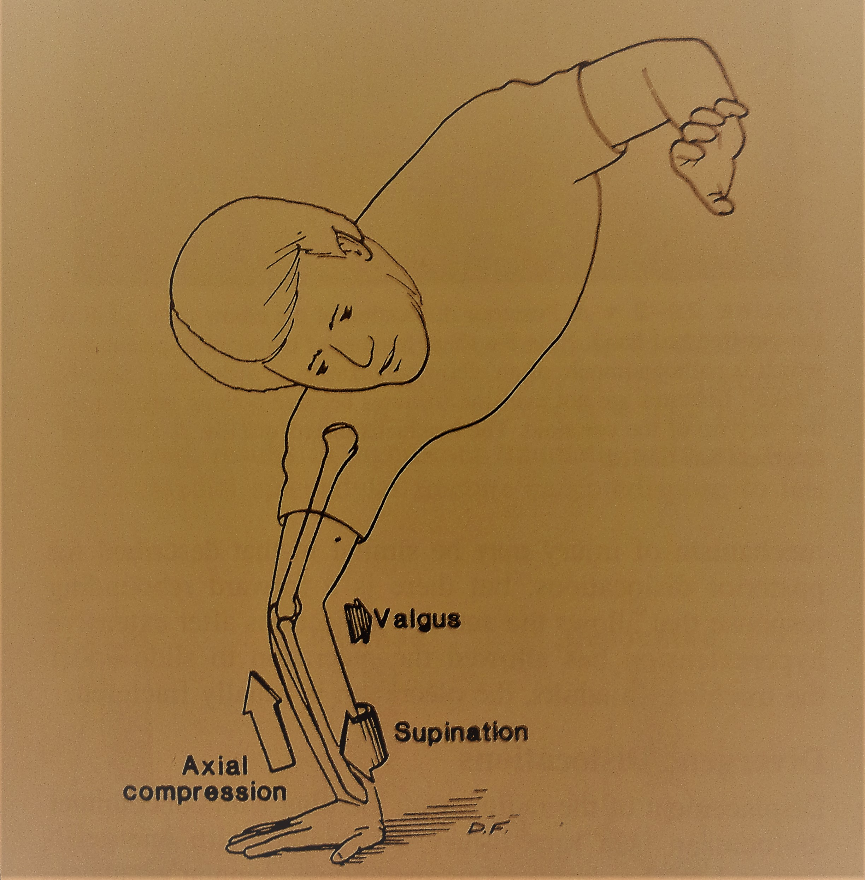
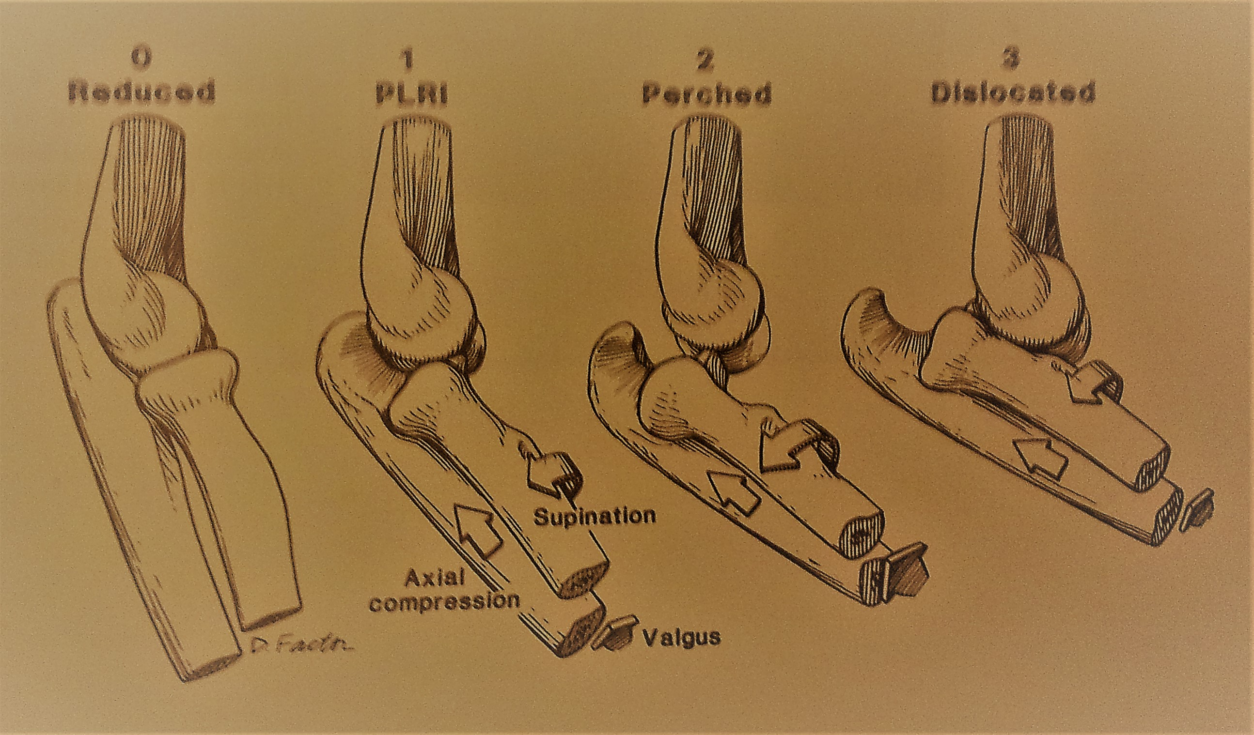

Slide 32
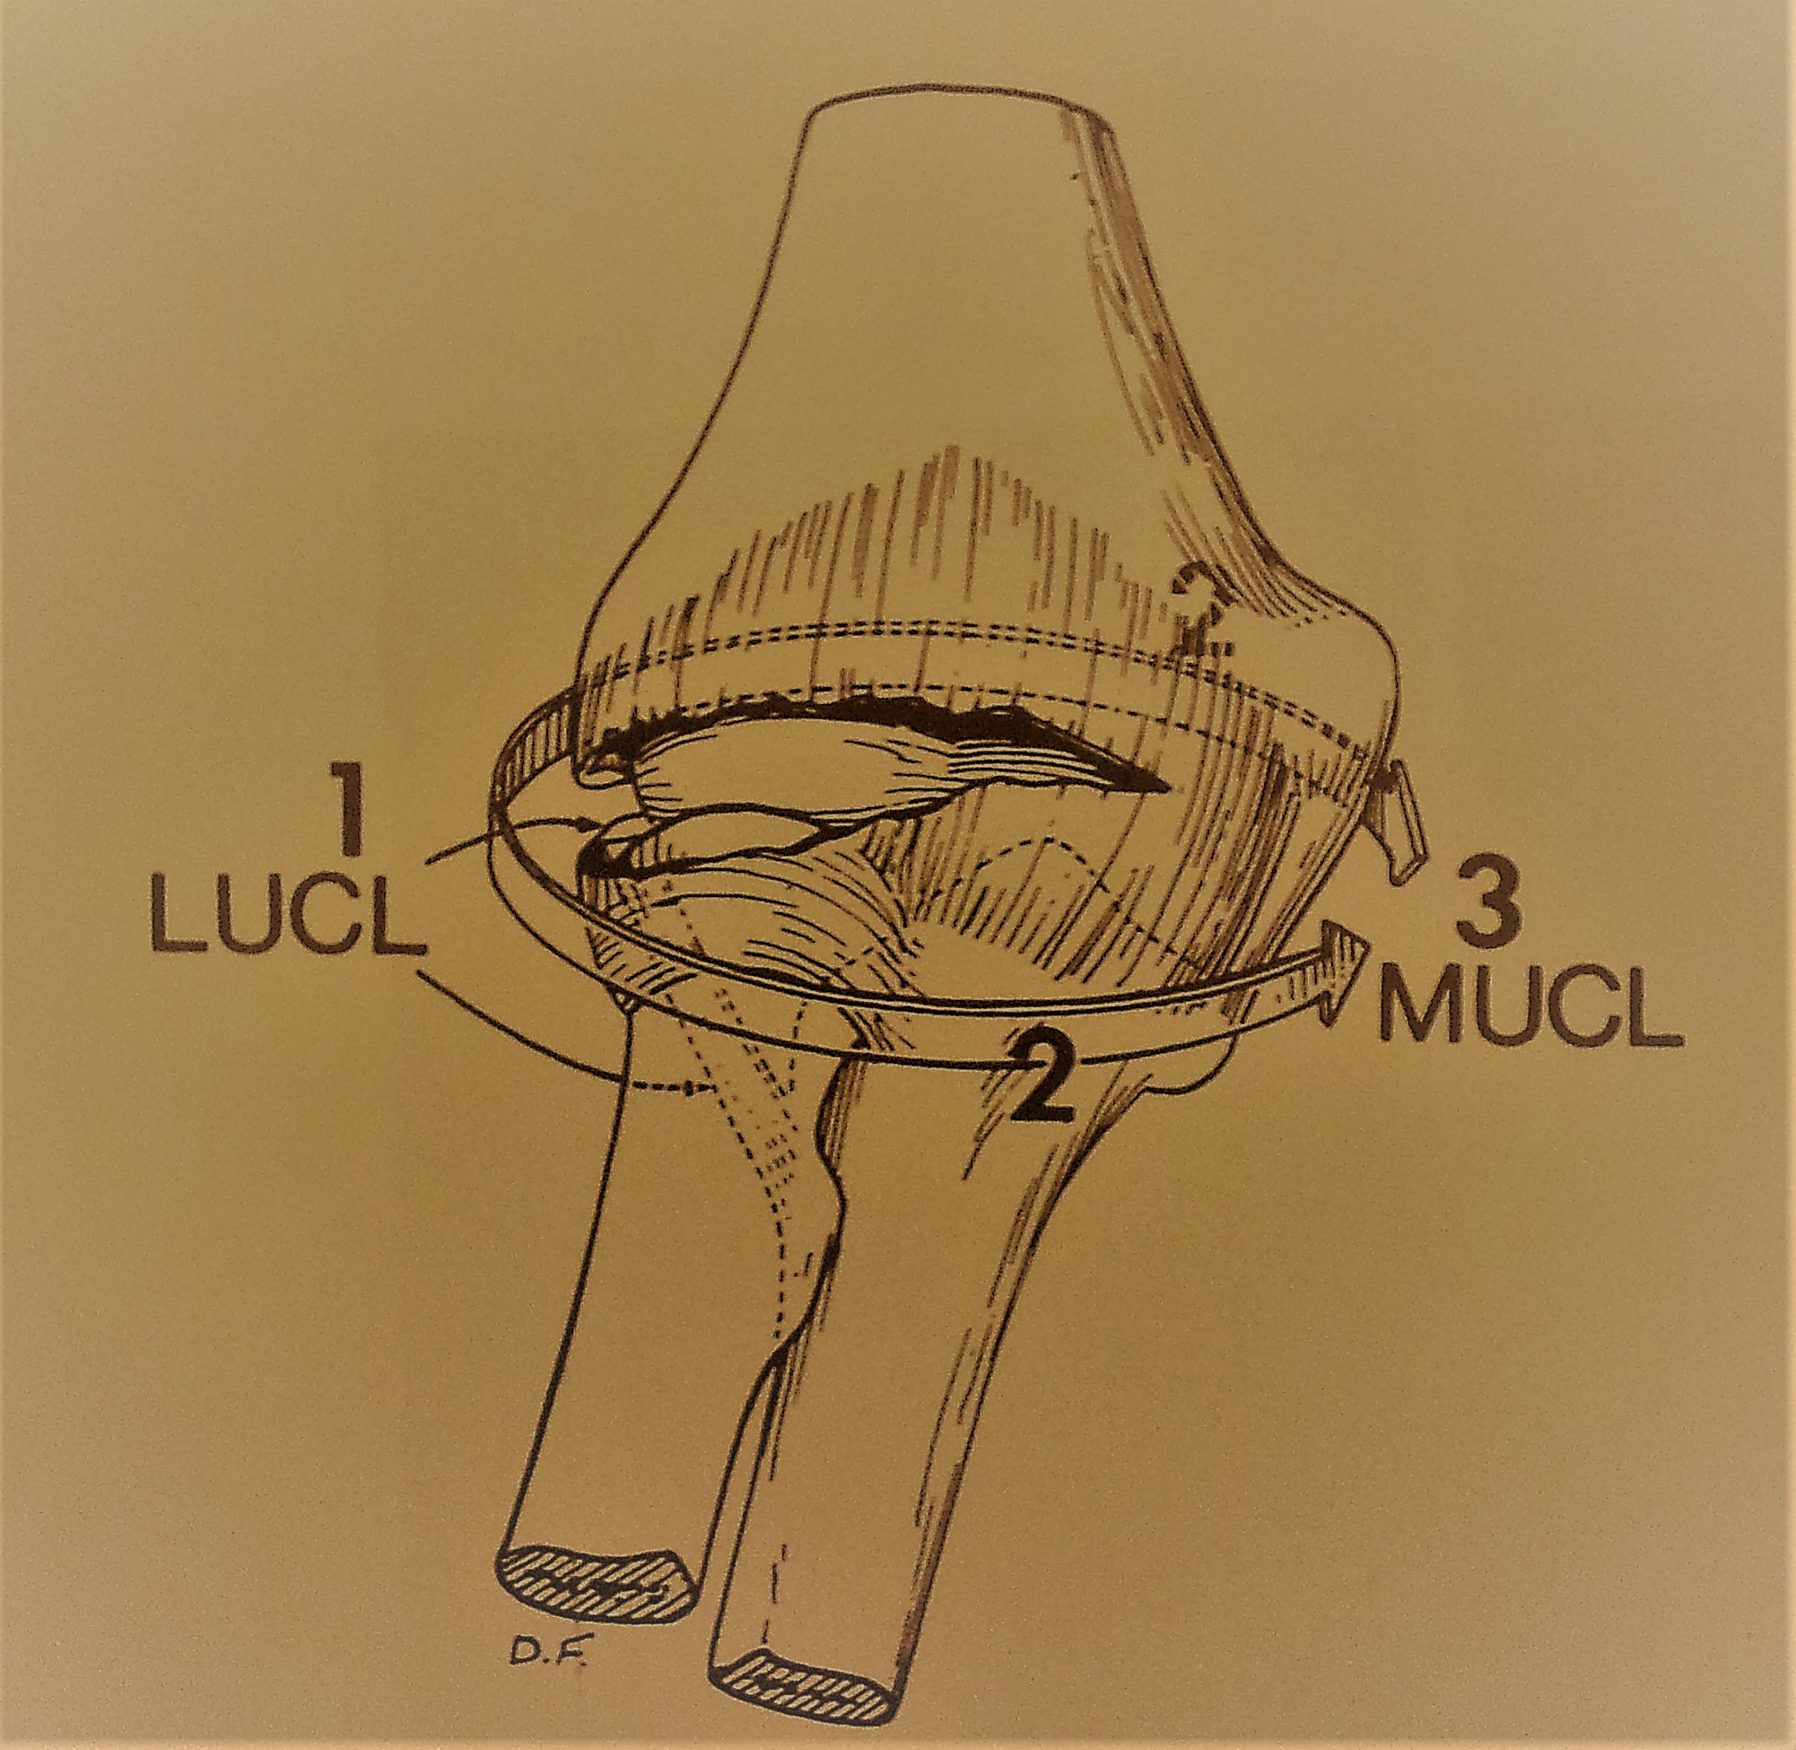

Slide 33
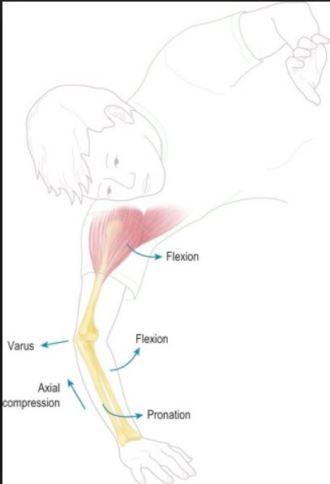
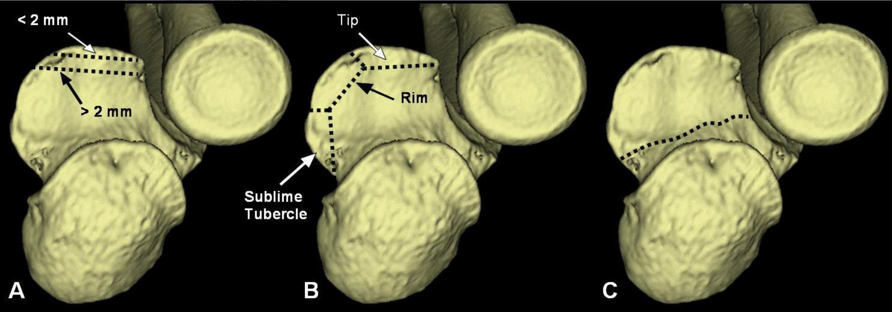
Notes:
O’Driscoll beosztás

Slide 34
Radial head replacement

Slide 35
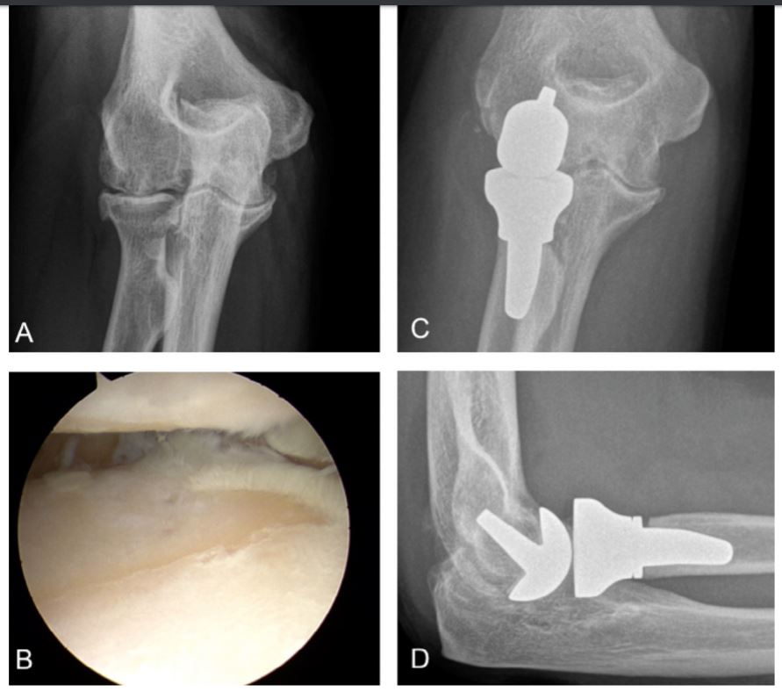

Slide 36
Total elbow replacement

Slide 37
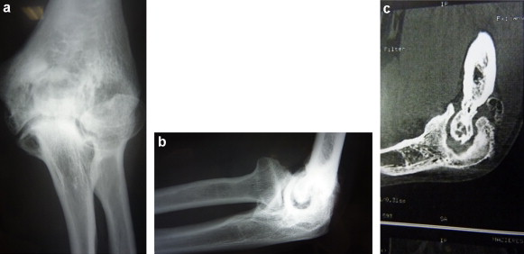

Slide 38
